Slide 1
Rook-Deployed Scalable NFS Clusters Exporting CephFS
Jeff Layton
Principal Software Engineer
Patrick Donnelly
Senior Software Engineer
CephFS Team Lead
Notes:
Rook was developed as a storage provider for Kubernetes to automatically deploy and attach storage to pods. Significant effort within Rook has been devoted to integrating the open-source storage platform Ceph with Kubernetes. Ceph is a distributed storage system in broad use today that presents unified file, block, and object interfaces to applications.
This talk will present completed work in the Ceph Nautilus release to dynamically create highly-available and scalable NFS server clusters that export the Ceph file system (CephFS) for use within Kubernetes or as a standalone appliance. CephFS provides applications with a friendly programmatic interface for creating shareable volumes. For each volume, Ceph and Rook cooperatively manage the details of dynamically deploying a cluster of NFS-Ganesha pods with minimal operator or user involvement.
Tuesday June 25, 2019 14:20 - 14:55
609
KC+CNC - Storage
https://www.lfasiallc.com/events/kubecon-cloudnativecon-china-2019/schedule-english/

Slide 2
What is Ceph(FS)?
Rook-Deployed Scalable NFS Clusters Exporting CephFS
CephFS is a POSIX distributed file system.
Clients and MDS cooperatively maintain a distributed cache of metadata including inodes and directories
MDS hands out capabilities (aka caps) to clients, to allow them delegated access to parts of inode metadata
Clients directly perform file I/O on RADOS
Client
open
mkdir
listdir
Active
MDS
Standby MDS
Active MDS
Metadata Mutations
Metadata Exchange
read
write
Journal
Journal
Journal Flush
RADOS
Data Pool
Metadata Pool
Notes:
Early efforts to create an HPC file system giving nodes unencumbered access to the data path.

Slide 3



Ceph, an integral component of hybrid clouds
Rook-Deployed Scalable NFS Clusters Exporting CephFS
Manila:
A file share service for VMs
Uses CephFS to provision shared volumes.
Cinder:
A block device provisioner for VMs.
Uses Ceph’s RADOS Block Device (RBD).
Notes:
Origins of this effort are in Openstack and Manila.

Slide 4
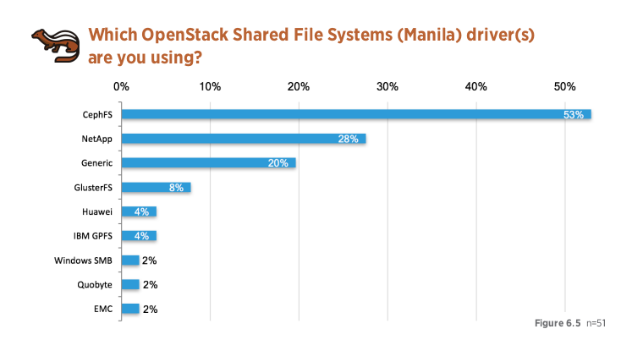
CephFS usage in community Openstack
Rook-Deployed Scalable NFS Clusters Exporting CephFS
Most Openstack users are also running a Ceph cluster already
Open source storage solution
CephFS metadata scalability is ideally suited to cloud environments.
https://www.openstack.org/user-survey/survey-2017
Notes:
So how does Kubernetes fit in? That will become clear towards the end!

Slide 5
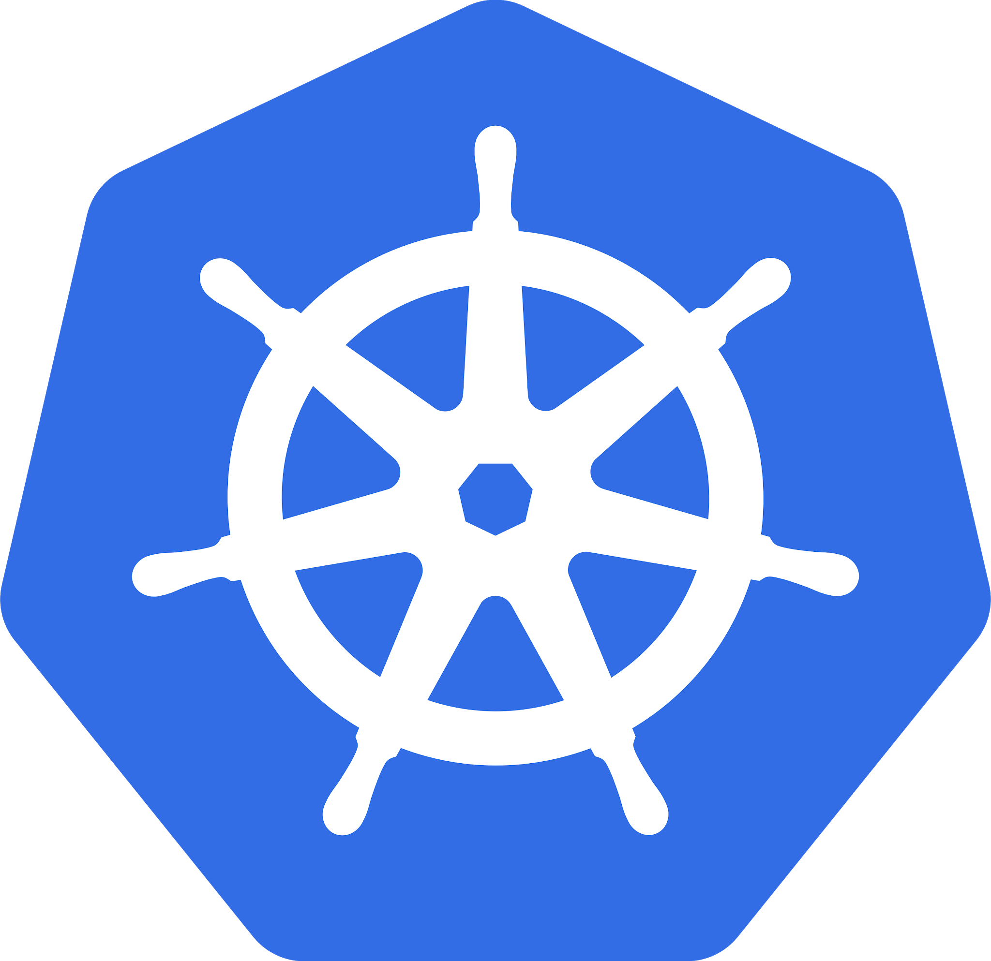
So why Kubernetes?
Rook-Deployed Scalable NFS Clusters Exporting CephFS
Lightweight Containers!
Trivial to spin up services in response to changing application needs. Extensible service infrastructure!
Parallelism
Containers are lightweight enough for lazy and optimal parallelism!
Fast/Cheap Failover
Service failover only requires a new pod.
Fast IP Failover/Management
Filesystem shared between multiple nodes
...but also tenant-aware
Notes:
Not necessarily missing from Openstack...

Slide 6


Why Would You Need a Ceph/NFS Gateway?
Rook-Deployed Scalable NFS Clusters Exporting CephFS
Ceph
Clients that can’t speak Ceph properly
old, questionable, or unknown ceph drivers (old kernel)
3rd party OSs
Security
Partition Ceph cluster from less trusted clients
GSSAPI (kerberos)
Openstack Manila
Filesystem shared between multiple nodes
...but also tenant-aware
...and self-managed by tenant admins
ceph-fuse
Metadata RPC
MDS
File I/O
RADOS
kernel
OSD
OSD
Notes:
Those exact goals run counter to desired I/O access in some scenarios.

Slide 7





Active/Passive Deployments
Rook-Deployed Scalable NFS Clusters Exporting CephFS
One active server at a time that “floats” between physical hosts
Traditional “failover” NFS server, running under pacemaker/corosync
Scales poorly + requires idle resources
Available since Ceph Luminous (~Aug 2017)

Slide 8
Goal: Active/Active Deployment
Rook-Deployed Scalable NFS Clusters Exporting CephFS
NFS Servers
NFS Clients

Slide 9




Goals and Requirements
Rook-Deployed Scalable NFS Clusters Exporting CephFS
Scale Out
Containerizable
NFSv4.1+
Ceph/RADOS for Communication
Active/Active cluster of mostly independent servers. Keep coordination between them to a bare minimum.
Leverage container orchestration technologies to simplify deployment and handle networking. No failover of resources. Just rebuild containers from scratch when they fail.
Avoid legacy NFS protocol versions, allowing us to rely on new protocol features for better performance, and possibility for pNFS later.
Avoid need for any 3rd party clustering or communication between cluster nodes. Use Ceph and RADOS to coordinate

Slide 10

Ganesha NFS Server
Rook-Deployed Scalable NFS Clusters Exporting CephFS
Open-source NFS server that runs in userspace (LGPLv3)
Plugin interface for exports and client recovery databases
well suited for exporting userland filesystems
FSAL_CEPH uses libcephfs to interact with Ceph cluster
Can use librados to store client recovery records and configuration files in RADOS objects
Amenable to containerization
Store configuration and recovery info in RADOS
No need for writeable local fs storage
Can run in unprivileged container
Rebuild server from r/o image if it fails

Slide 11
NFS Protocol
Rook-Deployed Scalable NFS Clusters Exporting CephFS
Based on ONC-RPC (aka SunRPC)
Early versions (NFSv2 and v3) were stateless
with sidecar protocols to handle file locking (NLM and NSM)
NFSv4 was designed to be stateful, and state is leased to the client
client must contact server at least once every lease period to renew (45-60s is typical)
NFSv4.1 revamped protocol using a sessions layer to provide exactly-once semantics
added RECLAIM_COMPLETE operation (allows lifting grace period early)
more clustering and migration support
NFSv4.2 mostly new features on top of v4.1

Slide 12
NFS Client Recovery
Rook-Deployed Scalable NFS Clusters Exporting CephFS
After restart, NFS servers come up with no ephemeral state
Opens, locks, delegations and layouts are lost
Allow clients to reclaim state they held earlier for ~2 lease periods
Detailed state tracking on stable storage is quite expensive
Ganesha had support for storing this in RADOS for single-server configurations
During the grace period:
No new state can be established. Clients may only reclaim old state.
Allow reclaim only from clients present at time of crash
Necessary to handle certain cases involving network partitions
Must keep stable-storage records of which clients are allowed to reclaim after a reboot
Prior to a client doing its first OPEN, set a stable-storage record for client if there isn’t one
Remove after last file is closed, or when client state expires
Atomically replace old client db with new just prior to ending grace period

Slide 13
NFS Server Reboot Epochs
Rook-Deployed Scalable NFS Clusters Exporting CephFS
Grace Period
Normal
Ops
Grace Period
Normal
Ops
Grace Period
Normal
Ops
Epoch 1
Epoch 2
Epoch 3
Consider each reboot the start of a new epoch
As clients perform first open (reclaim or regular), set a record for them in a database associated with current epoch
During grace period, allow clients that are present in the previous epoch’s database to reclaim state
After transition from Grace to Normal operations, can delete any previous epoch’s database
The same applies in a cluster of servers!

Slide 14
New in Ganesha: Coordinating Grace Periods
Rook-Deployed Scalable NFS Clusters Exporting CephFS
Done via central database stored in a RADOS object
Two 64-bit integers:
Current Epoch (C): Where should new records be stored?
Recovery Epoch (R): From what epoch should clients be allowed to reclaim?
R == 0 means grace period is not in force (normal operation)
Flags for each node indicating current need for a grace period and enforcement status
NEED (N): does this server currently require a grace period?
First node to set its NEED flag declares a new grace period
Last node to clear its NEED flag can lift the grace period
ENFORCING (E): is this node enforcing the grace period?
If all servers are enforcing then we know no conflicting state can be handed out (grace period is fully in force)
Simple logic to allow individual hosts to make decisions about grace enforcement based on state of all servers in cluster. No running centralized entity.

Slide 15
Challenge: Layering NFS over a Cluster FS
Rook-Deployed Scalable NFS Clusters Exporting CephFS
Both protocols are stateful, and use lease-based mechanism. Ganesha acts as a proxy.
Example: ganesha server may crash and a new one started:
Client issues request to do a open NFS reclaim
Ganesha performs an open request via libcephfs
Blocks, waiting for caps held by previous ganesha instance
Default MDS session timeout is 60s
Session could also die before other servers are enforcing grace period

Slide 16

New In Nautilus: Client Reclaim of Sessions
Rook-Deployed Scalable NFS Clusters Exporting CephFS
When a CephFS client dies abruptly, the MDS keeps its session around for a little while (several minutes). Stateful info (locks, opens, caps, etc.) are tied to those sessions.
Added new interfaces to libcephfs to allow ganesha to request that its old session be killed off immediately.
May eventually add ability for session to take over old stateful objects, obviating need for grace period on surviving server heads. https://tracker.ceph.com/issues/36397

Slide 17
Challenge: Deploy and Manage NFS Clusters
Rook-Deployed Scalable NFS Clusters Exporting CephFS
Dynamic NFS cluster creation/deletion
Scale in two directions:
active-active configuration of NFS clusters for a hot subvolumes
per-subvolume independent NFS clusters
Handling failures + IP migration
Spawn replacement NFS-Ganesha daemon and migrate the IP address.
Note: NFS clients cannot modify the NFS server’s IP address post-mount

Slide 18

Tying it all together with Rook and Kubernetes
Rook-Deployed Scalable NFS Clusters Exporting CephFS
rook.io is cloud-native storage orchestrator that can deploy ceph clusters dynamically.
Ceph aware of deployment technology!
Rook operator handles cookie-cutter configuration of daemons
CephNFS resource type in k8s
Integration with orchestrator ceph-mgr module
Deploy new clusters
Scale node count up or down
Dashboard can add+remove exports
Can scale NFS cluster size up or down (MDS too in the future!)

Slide 19
Ceph Nautilus: Mechanisms in Place
Rook-Deployed Scalable NFS Clusters Exporting CephFS
Volume management integrated in Ceph to provide a SSOT for CephFS exports.
Volumes provide an abstraction for CephFS file systems.
Subvolumes provide an abstraction for indepdent CephFS directory trees.
Manila/Rook/<X> all use the same interface.
Ceph/Rook integration in place to launch NFS-Ganesha clusters to export subvolumes.
Ceph management of exports and configs for NFS-Ganesha clusters.

Slide 20
Vision for the Future
Rook-Deployed Scalable NFS Clusters Exporting CephFS
Trivial creation/config of a managed volume with a persistent NFS Gateway.
NFS-Ganesha:
Add support for NFSv4 migration to allow redistribution of clients among servers
Optimizing grace periods for subvolumes.
SMB integration (samba)
14.2.2
$ ceph fs subvolume create vol_a subvol_1
$ ceph fs subvolume set vol_a subvol_1 <nfs-config…>
$ ceph fs subvolume set vol_a subvol_1 sharenfs true
14.2.3+

Slide 21
Thank you
OPTIONAL SECTION MARKER OR TITLE
Jeff Layton jlayton@redhat.com
Patrick Donnelly pdonnell@redhat.com
Blog Demo: https://ceph.com/community/deploying-a-cephnfs-server-cluster-with-rook/
New in Nautilus: CephFS Improvements: https://ceph.com/community/nautilus-cephfs/
Rook: https://rook.io/
Ceph: https://ceph.com/
NFS Ganesha: https://www.nfs-ganesha.org/

Slide 22
Appendix

Slide 23
CephFS and Client Access
Rook-Deployed Scalable NFS Clusters Exporting CephFS
Ceph
CephFS is a POSIX distributed file system.
Clients and MDS cooperatively maintain a distributed cache of metadata including inodes and directories
MDS hands out capabilities (aka caps) to clients, to allow them delegated access to parts of inode metadata
Clients directly perform file I/O on RADOS
Metadata RPC
MDS
ceph-fuse
Journal & Inodes
File I/O
RADOS
kernel
OSD
OSD
Notes:
Early efforts to create an HPC file system giving nodes unencumbered access to the data path.

Slide 24
Manila
/usr/bin/ceph
Share: CephFS Name
Export Paths Network Share (e.g. Neutron ID+CIDR) Share Server Count
REST API: Get/Put Shares (Publish Intent)
MGR
Scale-out & shares managed by mgr
MDS
OSD
OSD
OSD
HA managed by Kubernetes
Get Share/Config + Advertise to ServiceMap
Data IO
Metadata IO
Spawn Container in NW Share
Get/Put Client State (in RADOS)
Kubernetes Pod (HA Managed by Kubernetes)
Rook/Kubernetes + Kuryr (net driver)
NFSGW
Push config
Start grace period
Ganesha

Slide 25
CephFS
Rook-Deployed Scalable NFS Clusters Exporting CephFS
Metadata is handled via a Metadata Server (MDS)
clients establish a session with the MDS
CephFS MDS hands out capabilities (aka caps) to clients
recallable, delegated, granular parts of inode metadata:
AUTH - uid, gid, mode
LINK - link count
FILE - read/write ability, layout, file size, mtime
XATTR - xattrs
most come in shared/exclusive flavors
grant the clients the ability to do certain operations on an inode
tied to the client’s MDS session
libcephfs provides a (somewhat POSIX-ish) userland client interface

Slide 26
EOS

